Slide 1

ADVANCED MODELING FOR OPERATIONS
PROJECT PART 2
GROUP 3
DI NACCIO ELIANA 10679691
FERREIRA JOÃO 10975898
GIAMPIETRO LORENZO 10715923
MARTI INES 10988541
ZOCCATELLI LORENZO 10664683

Slide 2

1A
1B
IDENTIFY A SYSTEM PERFORMANCE MEASURE OF INTEREST
ESTIMATE THE SELECTED SYSTEM PERFORMANCE MEASURE BY SETTING THE RIGHT NUMBER OF RUNS AND (IF NEEDED) THE RUN LENGTH
GOALS AND OBJECTIVES
2A
2B
IDENTIFY A LIST OF POSSIBLE FACTORS TO INVESTIGATE
SELECT THE TWO MOST INTERESTING FACTORS
2C
2D
PERFORM THE ANOVA FOR THE TWO SELECTED FACTORS
ANALYZE AND COMMENT ON THE RESULTS

Slide 3


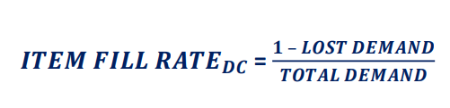

SYSTEM PERFORMANCE MEASURE: IFR
Item fill rate (IFR) is the ratio of satisfied customer demand to total demand over a pre-defined period.
In this assignment we used the IFR at the Distribution Center. This metric measures the efficiency of our distribution processes in meeting customer demand promptly. A high fill rate ensures customer satisfaction. Monitoring the item fill rate helps us made the necessary changes in our model to optimize inventory levels, preventing stockouts and improving overall supply chain responsiveness.

Slide 4

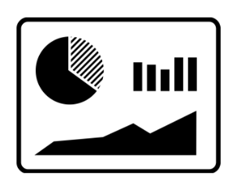
PERFORMANCE MEASURE
NUMBER OF RUNS
The goal is to evaluate the performance of the system under specific conditions. Particularly, the focus lies in evaluating the impact of a concrete disruptive event, which already determines the length of the runs.
In this case, we study the behavior of the grocery supply chain in light of a pandemic, and potentially, of other events that trigger a panic behavior. The length of the simulation will, therefore, be determined by the length of the pandemic, which we consider fixed in 30 days, and the consequent previous and later periods of normal times (i.e. without pandemic), in order to be able to evaluate the recovery of the system.
The aim is to define the number of runs needed to ensure a sufficiently high confidence in the performance results obtained.
FINITE HORIZON
SIMULATION

Slide 5
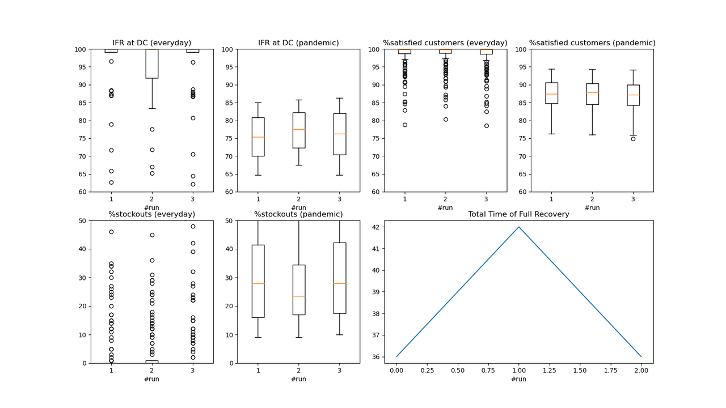
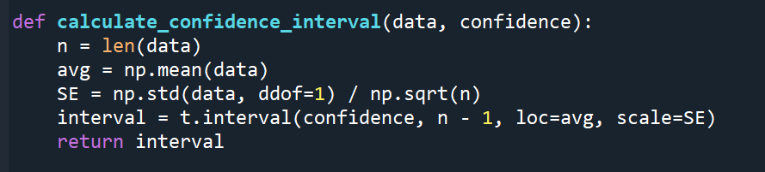
PERFORMANCE MEASURE
NUMBER OF RUNS
With the result summary that was implemented, it can be seen that the performances we get from the average results of 3 runs can be considered stable.
The total time of full recovery presents a difference of 5 days between some runs, but we decided to accept this variability
Besides the qualitative evaluation, we computed the confidence interval for the IFR during normal times, for a confidence level of the 95%, getting:
[94.7; 95.93]
We need to take into account that this agent-based simulation was computationally costly, and, although it is always more convenient to rely on a higher number of runs, we can find a compromise between accuracy and time of simulation by carrying out this analysis

Slide 6

POSSIBLE FACTORS TO INVESTIGATE
1) NUMBER OF BACK ORDERS
2) AVERAGE INVENTORY LEVEL AT STORE AND DC
3) DEMAND FORECAST ERROR
4) REPLENISHMENT QUANTITY
5) SS
6) NUMBER OF DCS

Slide 7



2 FACTORS CHOSEN
1. NUMBER OF DCS
Based on the improvements made in the updated version of the model, it’s interesting to choose the number of DCs and the amount of SS as input variables to vary, and observe and identify the corresponding changes in the output response.
2. SAFETY STOCKS

Slide 8

WHY: NUMBER OF DC
We decided to consider the number of DC as relevant factor as in a make-to-stock supply chain the capacity of the inventoryf buffer deployed rapresent the capability of the system to meet customer demand. A higher number of Distribution Centers in the system leads to higher availability of goods for retailers,less stock out expcted, thus an higher Item Fill Rate. The overall inventory capacity of the system it’s also a proxy of the operational flexibility of the system as it expresses how much the supply chain it’s able to absorb flactuatuion in the demand.

Slide 9

WHY: SAFETY STOCKS
In a make-stock-supply chain the safety stocks are one key to build redundancy,
which it’s about building additional resuources into the system to be used in case of disruptive event to mitigate the damages (protection strategy). Therefore safety stocks are directly affecting supply chain resilience, the capability of the system to mitigate disruptive events effects as well as the time needed to recover and restor the origional or new desired service level. We decided to consider safety stocks as relevant factor expecitng that with higher safety stocks the system will be able to absorb the panic behaviour spreading with a lower impact on service level, here expressed as Item Fill Rate.

Slide 10

ANOVA
ANOVA (Analysis of Variance) in supply chain simulation is a statistical technique that helps assess how and if variations in input factors impact the performance of the simulation model. It enables a systematic analysis of different factors to identify which ones significantly influence key outcomes, aiding in the optimization of supply chain processes for improved efficiency and resilience.
In our study, we identified two crucial variables: Number of Distribution Centers (DCs) and Safety Stocks. Through ANOVA modeling and experimentation with various values, we successfully defined fixed values to insert into our model. Establishing these values was a crucial part of our assignment, forming the foundation for our simulation model and ensuring alignment with our initial goals.
We built two files, one for each ANOVA we want to perform:
the first one runs the model with different numbers of DCs
the second one runs the model with different values for Safety Stocks

Slide 11

RESULTS
From both qualitative graphs and the quantitative F-test, we can notice that the features we decided to investigate affect the IFR. In particular, if we underestimate the number of DCs or the number of Safety Stocks, our performances crumble, while if we oversize the Safety Stocks or the number of DCs, we reach an almost perfect IFR that is unaffected by the pandemic. But at what cost can we implement so many DCs or SS? Of course, here is a tradeoff between the IFR achievable and the logistic cost. The values we identified (3 DCs and 225 SS) are a good compromise: they are the minimum values of DCs and SS needed to reach an average IFR in normal times of 95% and a minimum IFR higher than 60%

Slide 12
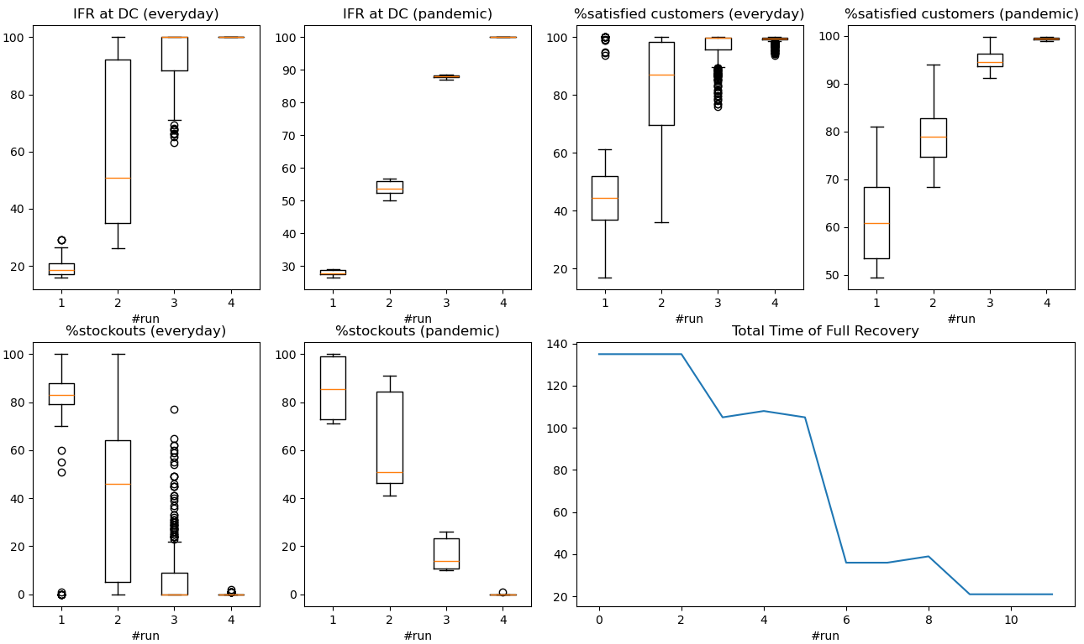

NUMBER OF DCS
Every three runs, we increase the number of DCs, to monitor how the performances of the model evolve in function of the number of DCs
In the first set of runs, there is only one DC in the model. In the following sets, we add one DC per set of runs.
NB: the level of safety stocks is always constant (like in our original model):
SS at store = 0, SS at DC = 225
It is evident from the graph that the performances change in a significative way together with the number of DCs: the more the DCs, the better our results. We notice that 3 DCs is a good compromise: it is the minimum number of DCs that allows us to get an IFR higher than 60 during the pandemic and an average IFR in normal times above 95%
<5% (alpha)
Also the ANOVA signals -quantitatively- that with different DCs we get different results of IFR

Slide 13
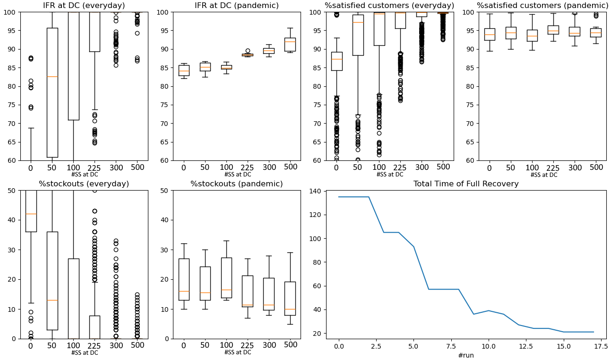

SAFETY STOCKS
We took the original model, and in each battery of runs we kept all parameters constant but the number of safety stocks.
SS of stores: we decided to not investigate this variable. In the real world, the SS held at the DC are way more important than those held by the stores
We try different values of Safety Stocks at DC:
[0, 50, 100, 225, 300, 500]
NB: the number of DCs is always constant (like in our original model):
#DCs = 3
<5% (alpha)
Also the ANOVA signals -quantitatively- that with different SSs we get different results of IFR

Slide 14

THANKS FOR WATCHING

